Slide 1
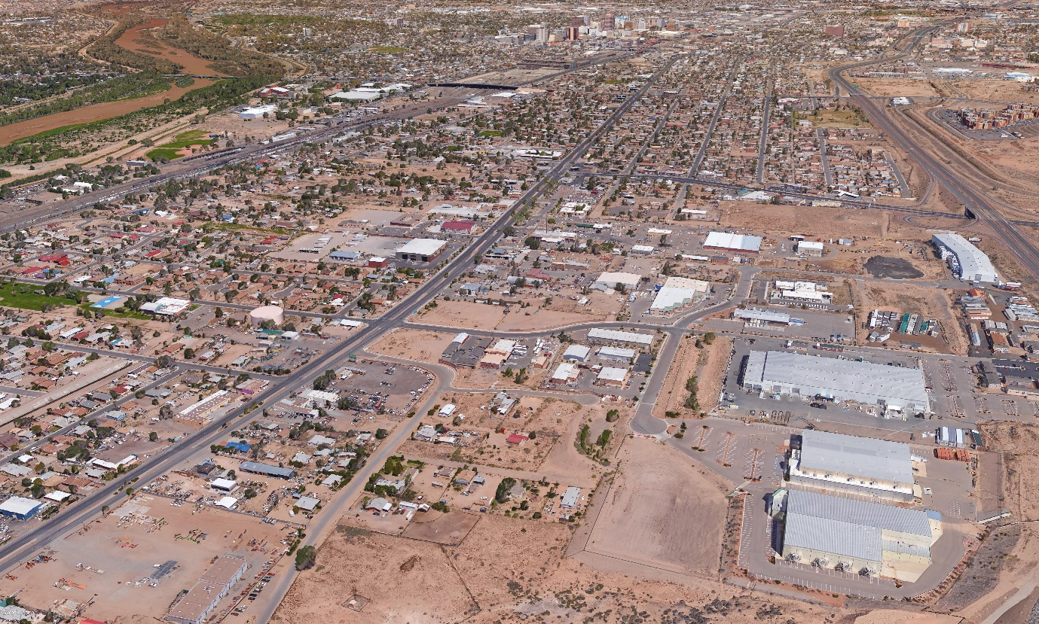
Item 19. South Broadway DMP – Comparison of 1999 and 2013 Plans
N

Slide 2
COMPARATIVE ANALYSIS OF PREVIOUS STUDIES
Bohannan-Huston, Inc. (BHI)
South Broadway Section Drainage Management Plan (1990)
Drainage Management Plan (DMP)
URS Corp. (URS)
South Broadway Drainage & Water Quality Management Plan (2013)
SBDWQMP

Slide 3
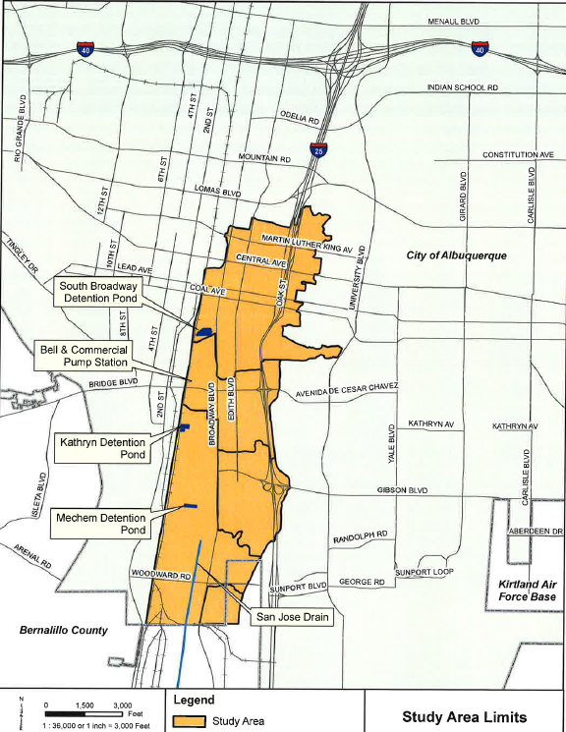
Study Area
Bounded by Roma Avenue to the north
City limit on the south
I – 25 on the east
South Diversion Channel on the southeast
Railroad tracks to the west

Slide 4
1990 Study
Used SWMM computer program to model hydrology and hydraulics of street flow, channel flow, pipe flow, pump hydraulics
10-year and 100-year 6-hour rainfall events modeled
Existing and developed conditions models prepared
Recommended a North Detention Pond and a South Detention Pond. Also recommended large stormdrains in Broadway
Ponds to form part of six collective Improvement Projects for South Broadway Sector
South Detention Pond – three possible locations

Slide 5
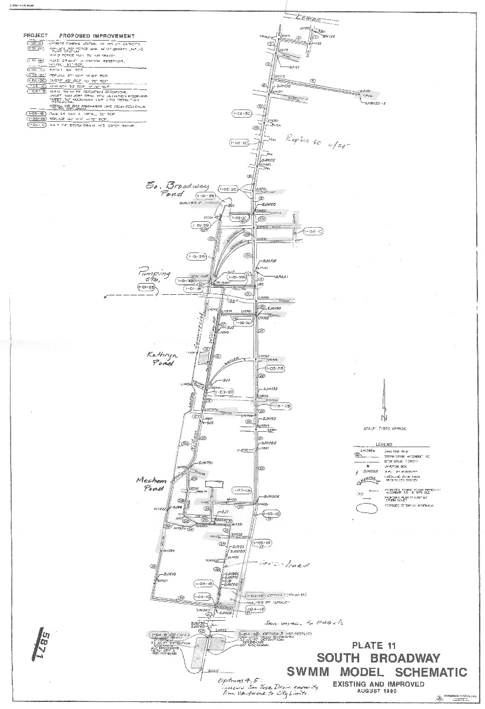

Slide 6
1990 Pond Storage Requirements
Pond Locations | Existing Storage Capacity (ac-ft)
North Detention Pond | 23 ac-ft*
South Detention Pond | 33 ac-ft*
North pond drains Bell-Commercial Pumpstation
South pond drains to San Jose Drain

Slide 7
1990 Assessment of San Jose Drain
San Jose Drain capacity computed at 350 cfs
Determined 100-year existing conditions discharge into San Jose Drain was 890 cfs
Recommended upsizing San Jose Drain for a length of 12,000 feet from Bethel Dr. to Riverside Drain and increasing capacity to 1140 cfs

Slide 8
2013 Study
Objective: to revise 1990 DMP, update hydrology, add storm sewer systems, make revisions
Used SWMM computer program to model hydrology and hydraulics
100-year 6-hour and 24-hour rainfall events modeled
Existing and developed conditions models prepared
Existing South Broadway, Kathryn, Mechem ponds incorporated into model
Six hydraulic subsystems to cover the study area
Six Improvement Options developed to reduce/eliminate flooding caused by 100-year 24 storm

Slide 9
2013 Study Recommended Improvements
Expand South Broadway Pond expansion -
Expand Kathryn Pond
Mechem Pond outlet modification
Edith Storm Drain

Slide 10
Differences between 1990 & 2013 Studies
1990 study existing conditions 100-year peak discharge into San Jose Drain = 890 cfs
2013 study existing conditions 100-year discharge at same point = 430 cfs
Difference attributed to changed hydrologic parameters since 1990 DMP
1990 DMP used NOAA Atlas 2
2013 Study used NOAA Atlas 14
2013 Study CN values determined using ArcMap calculated for the pervious areas of each watershed

Slide 11
Differences cont’d
1990 used 2 ponds in SWMM model (North Detention & South Detention Ponds)
1990 SWMM model extended south to city limit (South of Woodward) and included San Jose Drain
2013 study SWMM model stopped at Bethel
2013 study SWMM model options did not include San Jose Drain

Slide 12
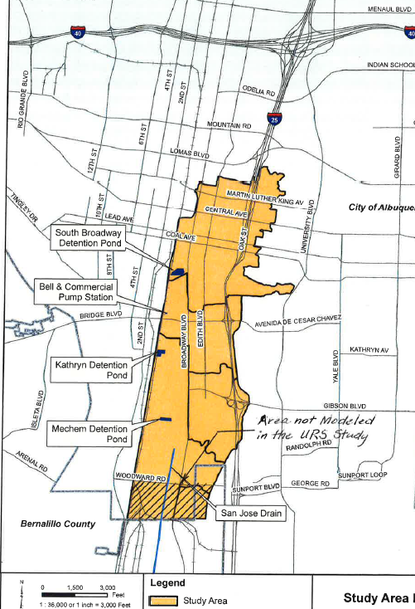
Area not Modeled in 2013 SWMM Model

Slide 13
2016 Existing Pond Storage Capacity
Pond Locations | Existing Storage Capacity (ac-ft)
South Broadway Detention Pond (1990 North) | 26.9 ac-ft
Kathryn Detention Pond | 6.6 ac-ft*
Mechem Detention Pond | 5.6 ac-ft*
*Kathryn and Mechem ponds drain to San Jose Drain

Slide 14
Conclusions
Volumetric loading into northern reach of San Jose Drain still significant and exceeds capacity.
Storm drains and inlets needed in Broadway
Model incomplete and should include entire San Jose Drain

