Slide 1
Photos taken 12-23-2016 Beverly Hills @ Retention Pond
Site visit / assessment by Abiel Carrillo, City Hydrology

Slide 2
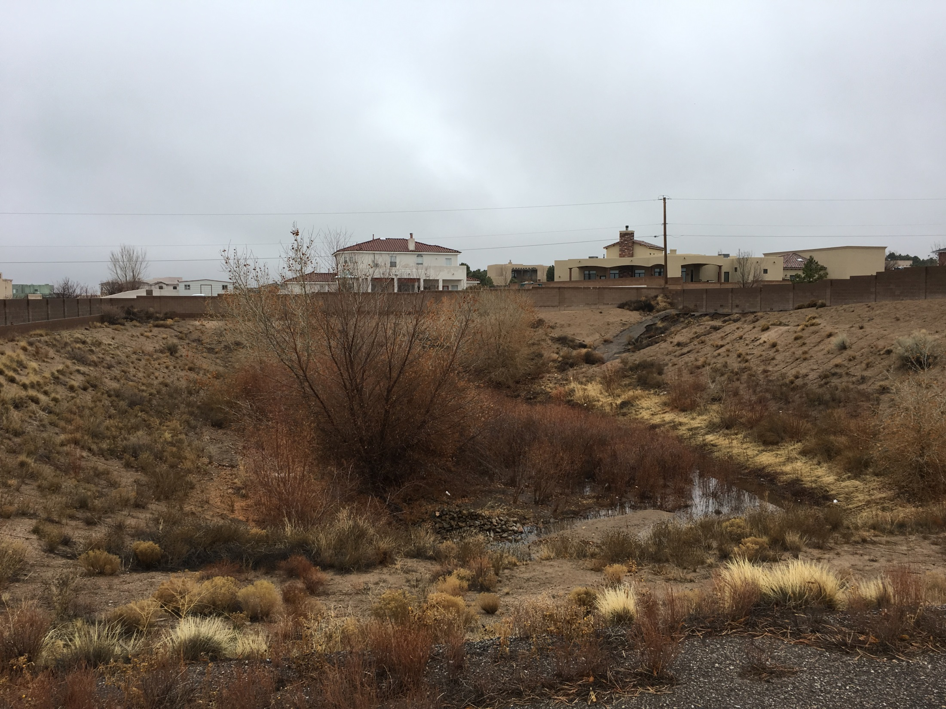

Slide 3
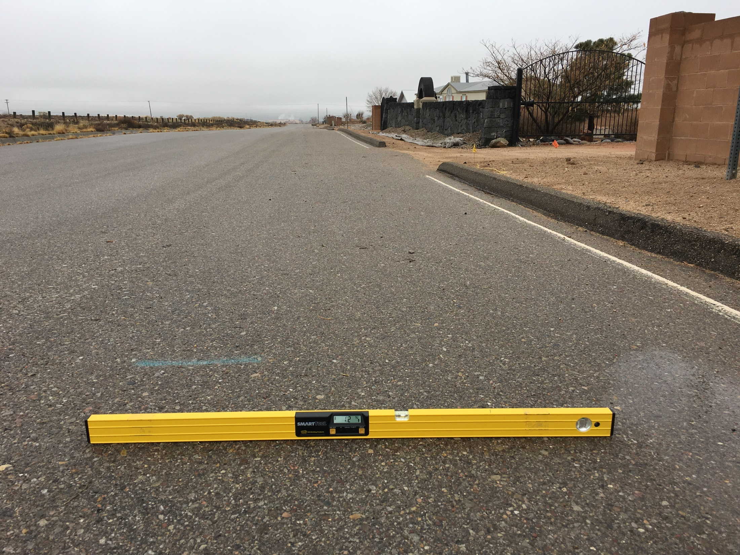
Beverly Hills
Slope 1-2% South
Facing West just West of Pond

Slide 4
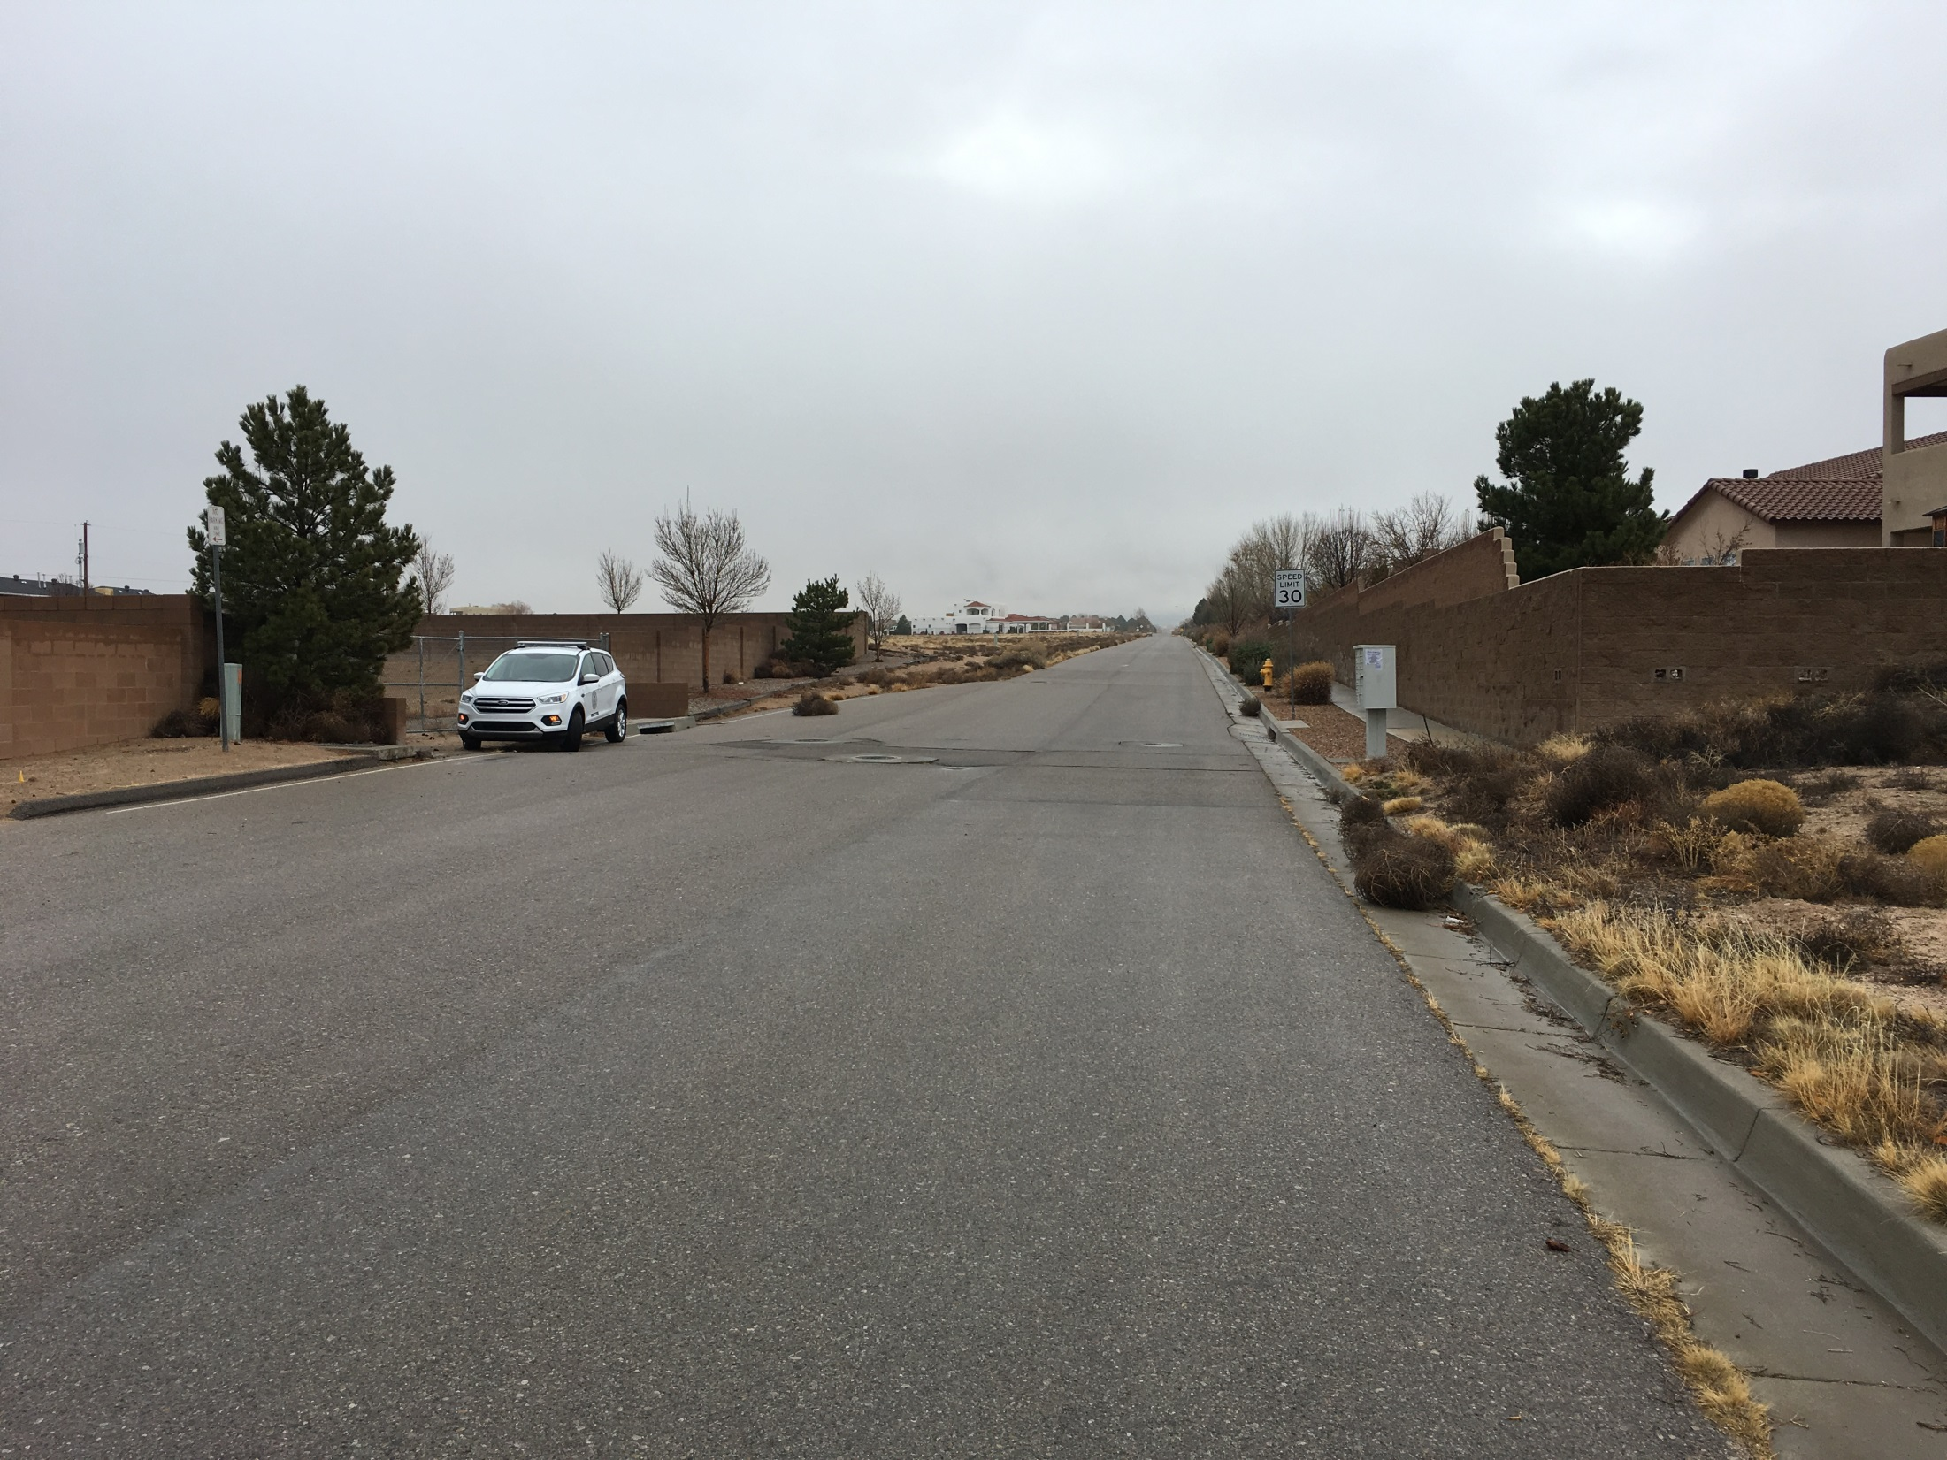
EAST
Pond
Overflow from Pond is transferred to the south side of the road and conveyed to the Arroyo at the T.

Slide 5
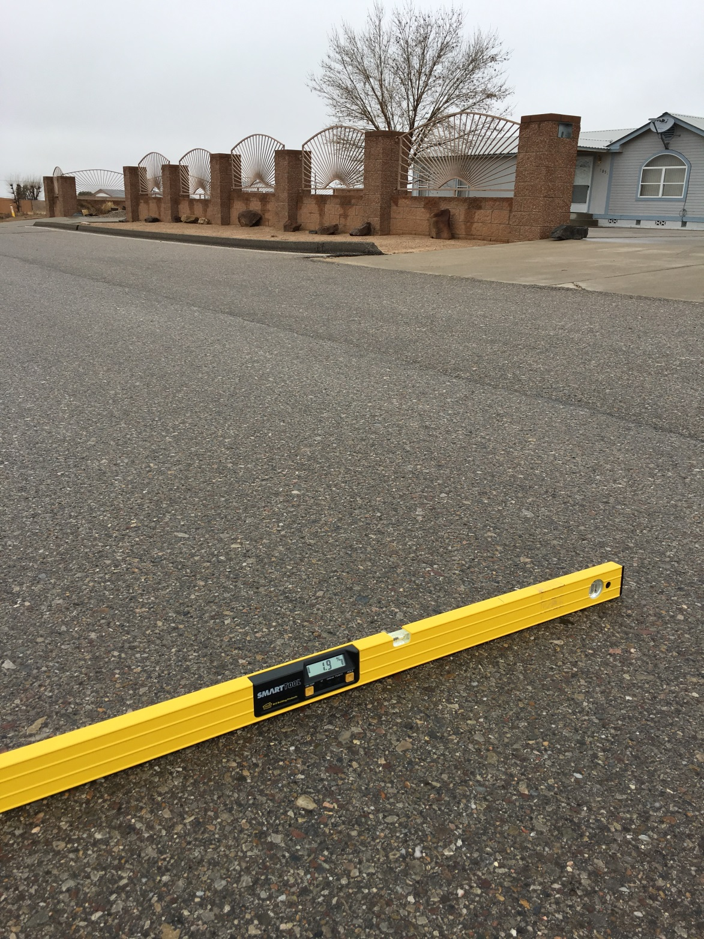

Slide 6
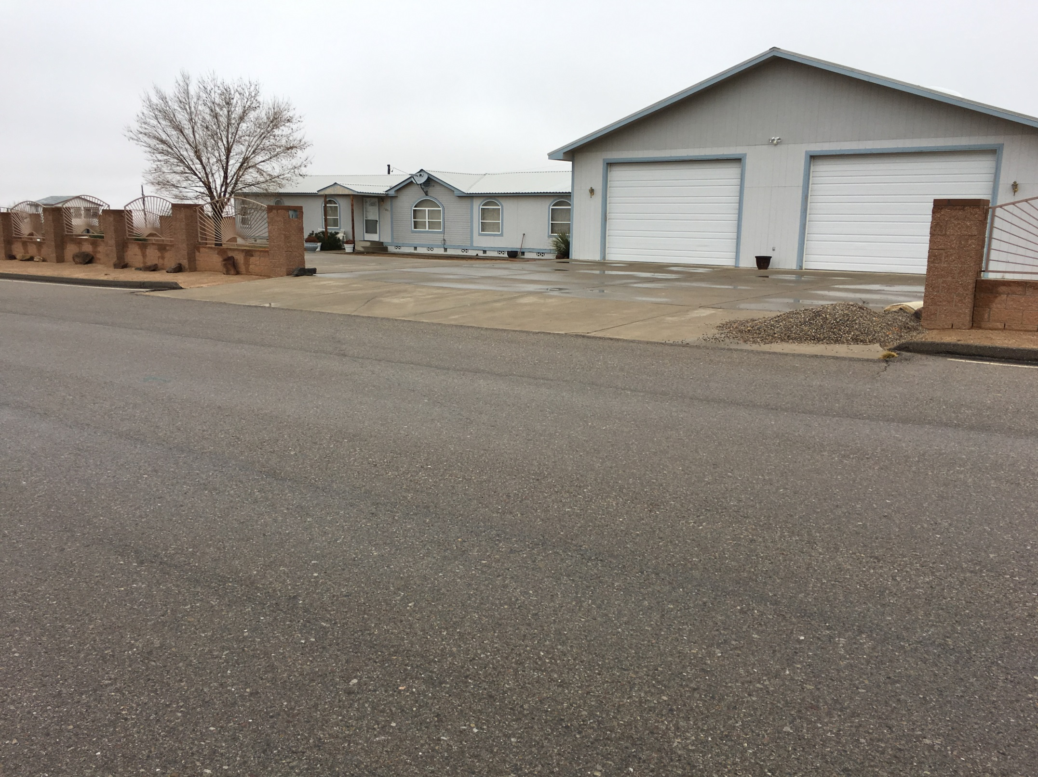
Roadway drains away from homes, some homes appear to have been built close to the road without proper drainage, such as above, but it does not appear that it is due to the right of way section

