Slide 1
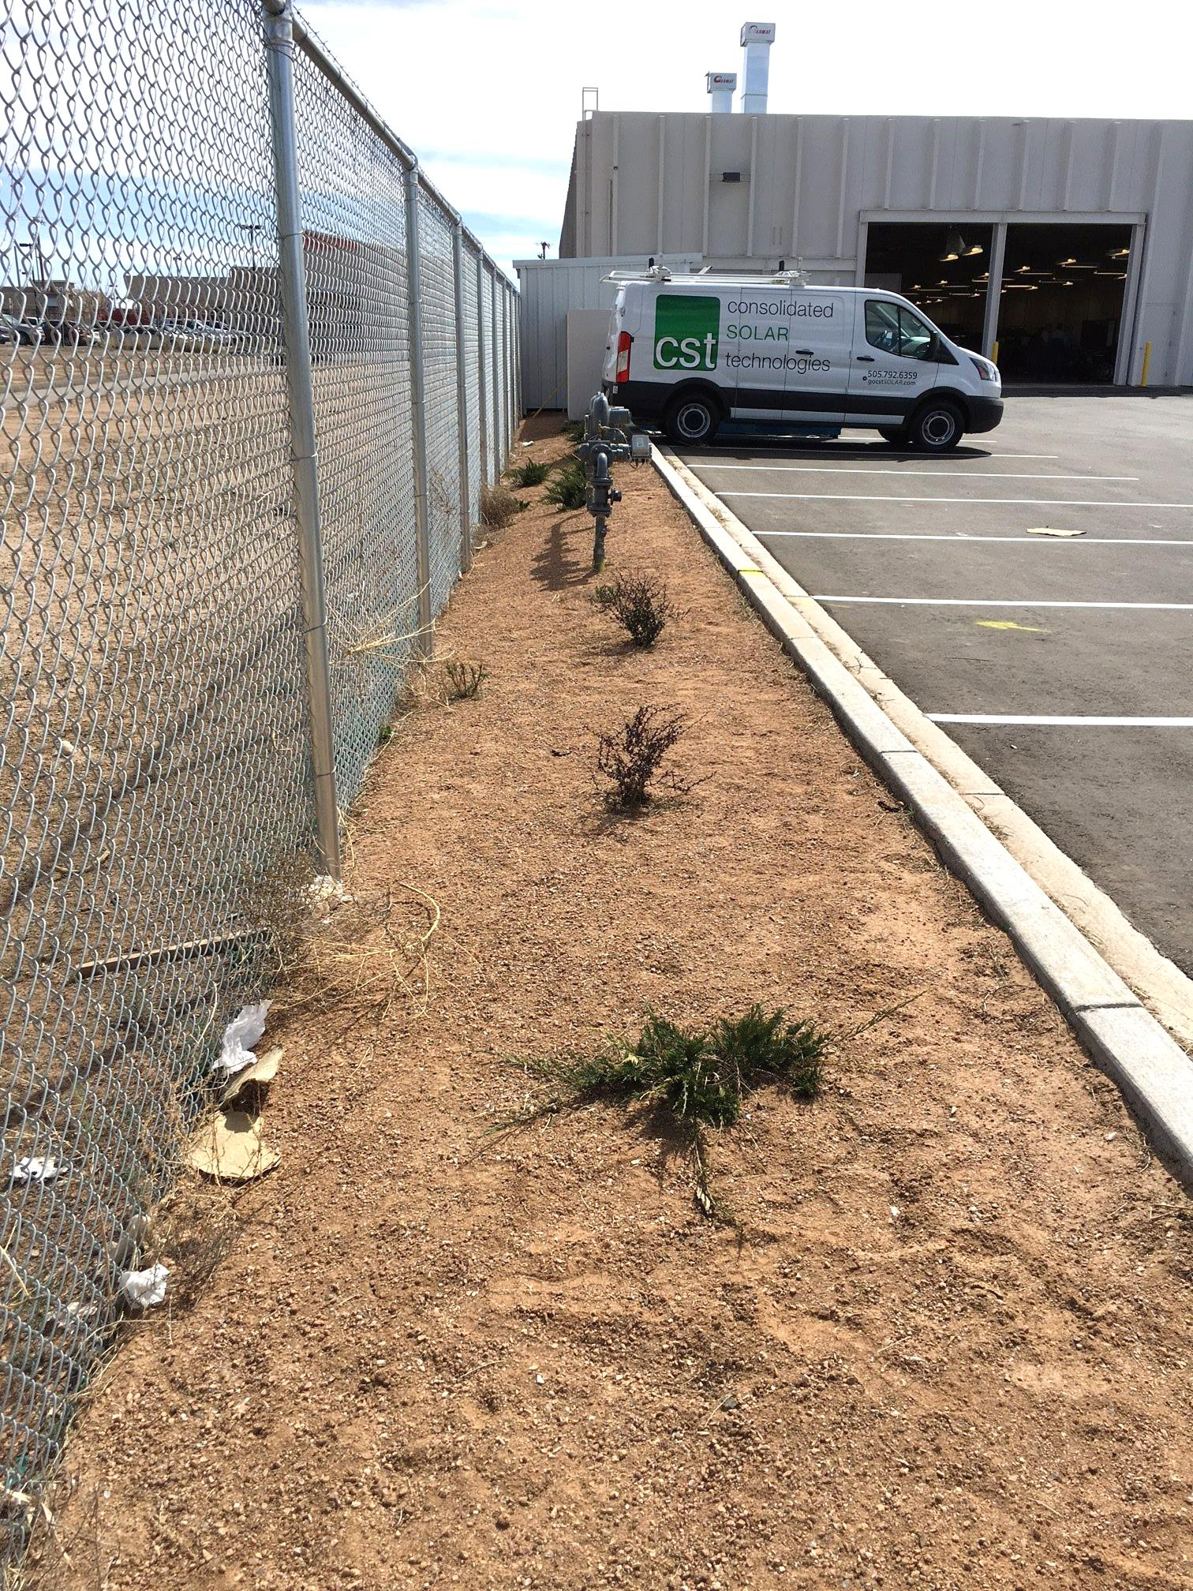
Swale needs to be well-defined, the shed cannot be a water block

