Slide 1
Tierra Linda Multi Family Development
Scoping Meeting
Our commitment is to understand the needs of our clients and to meet those needs by delivering professional services with the highest level of quality and integrity.

Slide 2
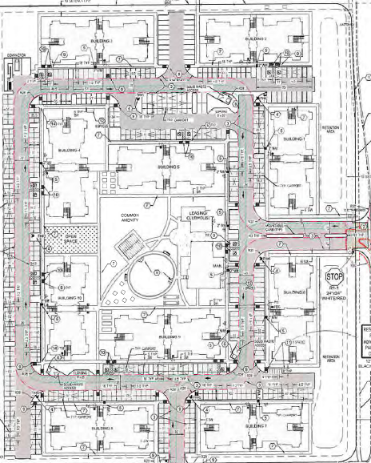
Site Plan
Dennis Chavez Blvd
98th St
Ceja Vista Rd

Slide 3
Site Plan (cont’d)
Dennis Chavez Blvd
Multifamily Building
Multifamily Building
Retention Area
Multifamily Building
Multifamily Building
Multifamily Building
Common Amenity, Leasing/ Clubhouse
98th St
Open Space
Multifamily Building
Multifamily Building
Multifamily Building
Retention Area
Multifamily Building
Multifamily Building
Ceja Vista Rd

Slide 4
Proposed Trips Generation
Land Use Code | AM Peak |  |  | PM Peak |  |  | Average Daily Traffic
 | Enter | Exit | TOTAL | Enter | Exit | TOTAL
220 – Multifamily Housing (240 Dwelling Units) | 23 | 74 | 97 | 78 | 46 | 124 | 1614

Slide 5
Study Intersections
6
Gibson Blvd
Legend
Project Area
Proposed Study Intersections
1- Mile Radius
5
Amole Mesa Ave
98th St
Unser Blvd
Coors Blvd
118th St
4
1
2
Dennis Chavez Blvd
3

Slide 6
Study Intersections List
6
Gibson Blvd
Dennis Chavez Blvd & 118th St
Dennis Chavez Blvd & 98th St
Dennis Chavez Blvd & Unser Blvd
Dennis Chavez Blvd & Coors Blvd
Amole Mesa Ave & 98th St
Gibson Blvd & 98th St
5
Amole Mesa Ave
98th St
Unser Blvd
Coors Blvd
118th St
4
1
2
Dennis Chavez Blvd
3

Slide 7
Models
Synchro 12 Software
ITE Trip Generation Manual 11th Ed
Models
Existing AM and PM Peak
No Build AM and PM Peak
Build Out AM and PM Peak
10 Year Horizon Year AM and PM Peak
Mitigations AM and PM Peak

Slide 8
Assumptions
Generate Trips based on ITE Trip Gen Land Use Code 210
Distribute Trips using Existing Traffic Volumes
Growth Rate 3.7% (Estimated using MRCOG AAWDT)
Notes:
AAWDT=Average Annual Weekday Traffic

Slide 9
Growth Rates

Slide 10
Questions

